Slide 1


Cloud Computing and Security
BIS613D
Module 5
Cloud Programming and Software Environments
Department of ISE

Slide 2
Parallel and Distributed Programming Paradigms

Slide 3
PARALLEL AND DISTRIBUTED PROGRAMMING
A distributed computing system is a set of computational engines connected by a network to achieve a common goal of running a job or an application.
A computer cluster or network of workstations is an example of a distributed computing system.
Parallel computing is the simultaneous use of more than one computational engine to run a job or an application.
For instance, parallel computing may use either a distributed or a non-distributed computing system such as a multi processor platform.

Slide 4
PARALLEL AND DISTRIBUTED PROGRAMMING
The system issues for running a typical parallel program in either a parallel or a distributed manner would include the following:
  Computation partitioning – splits a given job or a program into smaller tasks.
  Data partitioning – splits the input or intermediate data into smaller pieces.
  Mapping – assigns the either smaller parts of a program or the smaller pieces of data to underlying resources.
  Synchronization – different workers may perform different tasks, synchronization and coordination is required.
  Communication – always triggered when the intermediate data is sent to workers.
  Scheduling – For a job or program, when the number of computation parts (tasks) or data pieces is more than the number of available workers, a scheduler selects a sequence of tasks or data pieces to be assigned to the workers.

Slide 5
MapReduce, Twister, and Iterative MapReduce
MapReduce is a software framework which supports parallel and distributed computing on large data sets.
Abstracts the data flow of running a parallel program on a distributed computing system by providing users with two interfaces in the form of two functions: Map and Reduce
Users can override these two functions to interact with and manipulate the data flow of running their programs.
Figure 6.1 illustrates the logical data flow from the Map to the Reduce function in MapReduce frameworks.

Slide 6
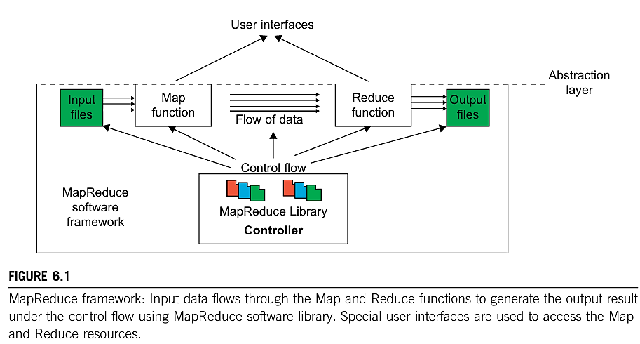
MapReduce, Twister, and Iterative MapReduce

Slide 7
Formal Definition of MapReduce
The MapReduce software framework provides an abstraction layer with the data flow and flow of control to users, and hides the implementation of all data flow steps such as data partitioning, mapping, synchronization, communication, and scheduling.
The abstraction layer provides two well-defined interfaces in the form of two functions: Map and Reduce

Slide 8
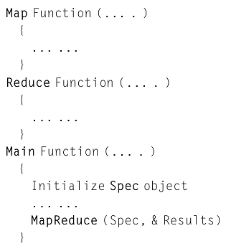
Formal Definition of MapReduce
The overall structure of a user’s program containing the Map, Reduce, and the Main functions are given below.
The Map and Reduce are two major subroutines. They will be called to implement the desired function performed in the main program.

Slide 9
MapReduce Logical Data Flow
The input data to both the Map and the Reduce functions has a particular structure and also pertains to the output data.
The input data to the Map function is in the form of a (key, value) pair.
For example, the key is the line offset within the input file and the value is the content of the line.
The output data from the Map function is structured as (key, value) pairs called intermediate (key, value) pairs.
In other words, the user-defined Map function processes each input (key, value) pair and produces a number of (zero, one, or more) intermediate (key, value) pairs.
Here, the goal is to process all input (key, value) pairs to the Map function in parallel (Figure 6.2).

Slide 10
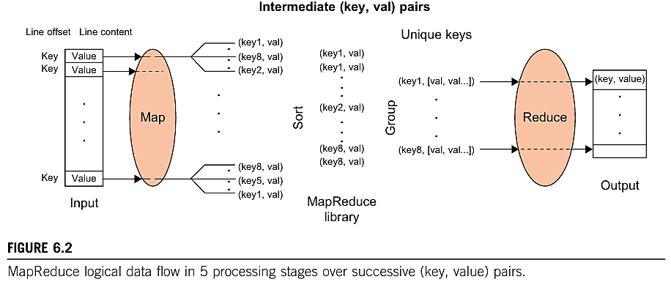
MapReduce Logical Data Flow

Slide 11
MapReduce Logical Data Flow
Figure 6.3 demonstrates the data flow of the word-count problem for a simple input file containing only two lines as follows:
(1) “most people ignore most poetry” and
(2) “most poetry ignores most people.”
In this case, the Map function simultaneously produces a
number of intermediate (key, value) pairs for each line of content so that each word is the inter mediate key with 1 as its intermediate value;
for example, (ignore, 1).

Slide 12
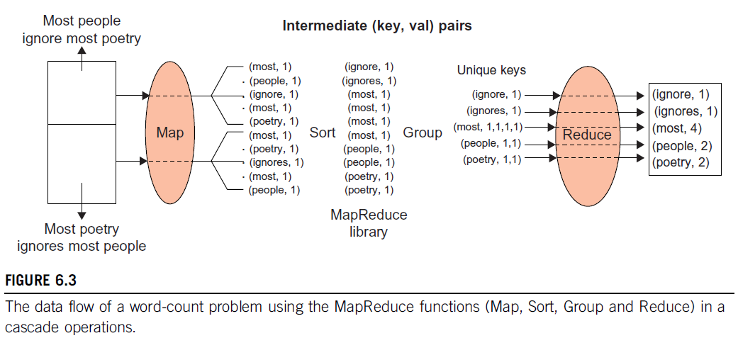
MapReduce Word-Count Problem Data Flow

Slide 13
MapReduce Logical Data Flow
Then the MapReduce library collects all the generated intermediate (key, value) pairs and sorts them to group the 1’s for identical words;
for example, (people, [1,1]).
Groups are then sent to the Reduce function in parallel so that it can sum up the 1 values for each word and generate the actual number of occurrence for each word in the file;
for example, (people, 2).

Slide 14
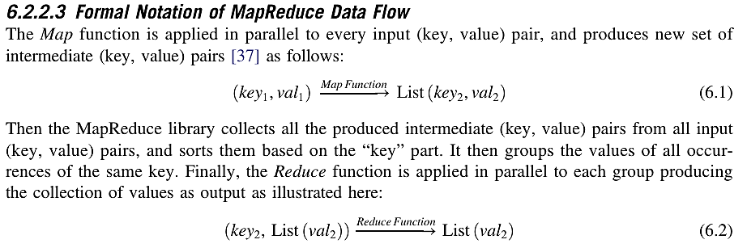

Slide 15
MapReduce Actual Data and Control Flow
Data partitioning – The MapReduce library splits the input data (files), already stored in GFS, into M pieces that also correspond to the number of map tasks.
Computation partitioning – users to write their programs in the form of the Map and Reduce functions.
Determining the master and workers – The MapReduce architecture is based on a master worker model. Therefore, one of the copies of the user program becomes the master and the rest become workers.

Slide 16
MapReduce Actual Data and Control Flow
Reading the input data (data distribution) – Each map worker reads its corresponding portion of the input data, namely the input data split, and sends it to its Map function.
Map function – Each Map function receives the input data split as a set of (key, value) pairs to process and produce the intermediated (key, value) pairs.
Combiner function – This is an optional local function within the map worker which applies to intermediate (key, value) pairs. The Combiner function merges the local data of each map worker before sending it over the network to effectively reduce its communication costs.

Slide 17
MapReduce Actual Data and Control Flow
Partitioning function – a hash function (e.g., Hash(key) mod R) that forwards the data into particular regions.
Figure 6.5 shows the data flow implementation of all data flow steps.
Synchronization – MapReduce applies a simple synchronization policy to coordinate map workers with reduce workers, in which the communication between them starts when all map tasks finish.

Slide 18
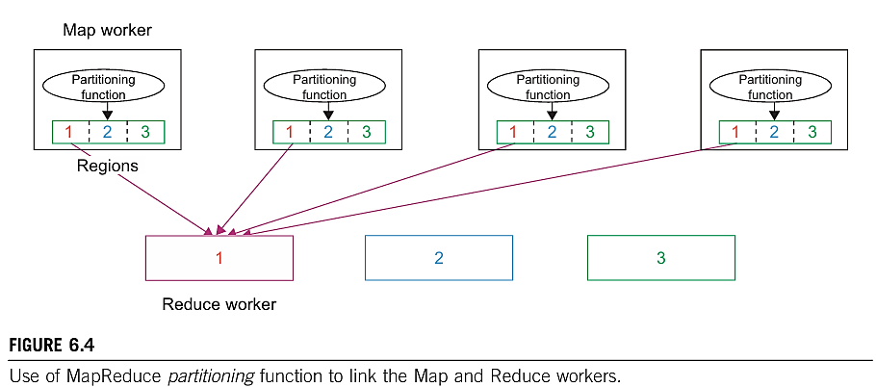
MapReduce Logical Data Flow

Slide 19
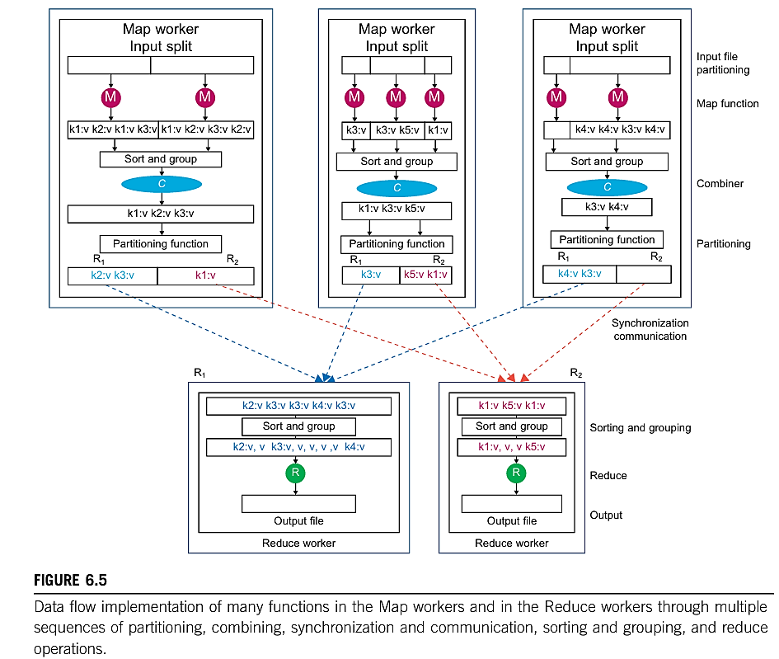
MapReduce Logical Data Flow

Slide 20
MapReduce Actual Data and Control Flow
Communication – Reduce worker i, already notified of the location of region i of all map workers, uses a remote procedure call to read the data from the respective region of all map workers.
Sorting and Grouping – When the process of reading the input data is finalized by a reduce worker, the data is initially buffered in the local disk of the reduce worker. Then the reduce worker groups intermediate (key, value) pairs by sorting the data based on their keys, followed by grouping all occurrences of identical keys.
Reduce function – The reduce worker iterates over the grouped (key, value) pairs, and for each unique key, it sends the key and corresponding values to the Reduce function.

Slide 21
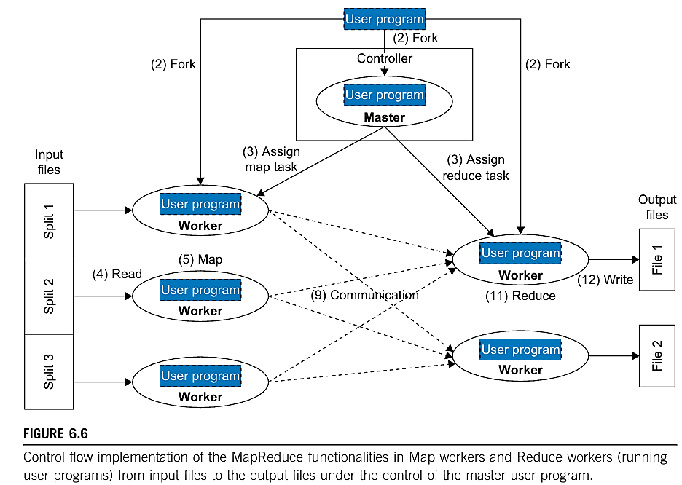
Figure 6.6 shows the exact order of processing control in such a system contrasting with dataflow in Figure 6.5.

Slide 22
Recollect Quiz
A ______________ is an example of a distributed computing system
______________ means different workers may perform different tasks, and hence _____________ and coordination is required.
______________ is a software framework which supports parallel and distributed computing on large data sets
The input data to the Map function is in the form of a ______________
The MapReduce architecture is based on a _________________
Notes:
computer cluster or network of workstations
Synchronization
MapReduce
(key, value) pair
master worker model

Slide 23
Possible Questions in the IAT/Exam
What are the system issues for running a typical parallel program in either a parallel or a distributed manner? Briefly explain.
Briefly explain the logical data flow of MapReduce architecture.
With a neat diagram explain the control flow implementation of MapReduce.
Formalize the MapReduce dataflow using mathematical functions.

Slide 24
.
THANK YOU

